Slide 1
Feature-Model
Feature
1
*
requirer
name: String
description: Text
binding-state: 3V-Boolean
optional: Boolean
1
*
Requires
requiree
1..*
2
*
Excludes
feature
involved
1..*
variant
parent
1
1
child
1
variation-point
refined-to
*
0..1
refined-from
0..1
0..1
Refinement
VP-Variant-Constraint
*
relation
Relation
Constraint
XOR
OR
state: 3V-Boolean
OCL Constraints:
context fm: Feature-Model
inv: fm.feature->select(refined-from->empty())->size = 1
context f: Feature
inv: f.refined-from->empty()
implies (not f.optional and f.binding-state)
context r: Refinement
inv: r.child.binding-state implies r.parent.binding-state
inv: not r.child.optional implies
(r.parent.binding-state implies r.child.binding-state)
context c: Requires
inv: c.state = (c.requirer.binding-state
implies c.requiree.binding-state)
context c: Excludes
inv: c.state = (c.involved->exists(binding-state <> true))
context c: VP-Variant-Constraint
inv: c.variant = c.variation-point.refined-to.child->asSet()
context c: OR
inv: c.state = (c.variation-point.binding-state
implies c.variant->exists(binding-state))
context c: XOR
inv: c.state = (c.variation-point.binding-state
implies c.variant->select(binding-state)->size = 1
①
②
③
④
⑤
⑥
⑦
⑧
⑨

Slide 2
Relation
*
PFM
relation
1..*
feature
requirer
Feature
1
*
Requires
refined-to
parent
name: String
description: Text
binding-state: 3V-Boolean
optional: Boolean
requiree
*
*
1
1
Refinement
Excludes
refined-from
child
2
*
0..1
1
involve
1..*
1..*
involve
1
variant
*
variation-point
Constraint
XOR
0..1
0..1
state: 3V-Boolean
formula: CNF
VP-Variant-Constraint
OR
OCL Constraints:
context fm: Feature-Model
inv: fm.feature->select(refined-from->empty())->size = 1
context f: Feature
inv: f.refined-from->empty()
implies (not f.optional and f.binding-state)
context r: Refinement
inv: r.child.binding-state implies r.parent.binding-state
inv: not r.child.optional implies
(r.parent.binding-state implies r.child.binding-state)
context c: Requires
inv: c.state = (c.requirer.binding-state
implies c.requiree.binding-state)
context c: Excludes
inv: c.state = (c.involved->exists(binding-state=false))
context c: VP-Variant-Constraint
inv: c.variant->forAll(refined-from.parent=c.variation-point)
context c: OR
inv: c.state = (c.variation-point.binding-state
implies c.variant->exists(binding-state=true))
context c: XOR
inv: c.state = (c.variation-point.binding-state
implies c.variant->select(binding-state=true)->size = 1)
context c: CNF-Constraint
inv: c.state = c.formula[f\f.binding-state, f∈c.involve] <> false
①
②
③
④
⑤
⑥
⑦
⑧
⑨
⑩

Slide 3
Mobile-Phone Service
Other Constraints:
¬(Content Display) ∨ (Route Navigation) ∨ (Message Service) ∨ (Picture) ∨ (Video)
Mobile-Phone Service
Calling Service
Internet Access
Route Navigation
Content Display
Multi-Media
Message Service
Calling Service
Message Service
Ringing Alert
Call Answer
Call Out
Online Update
Display Quality
Music
Picture
Video
Msg Receive
Msg Send
Ringing Alert
Call Answer
Call Out
Msg Receive
Msg Send
Ringtone Customize
Low Resolution
Medium Resolution
High Resolution
Msg Notify
Delivery Confirm
Ringtone Customize
Msg Notify
Legend
Optional Feature
Refinement
Requires
XOR
Ringtone Download
Mandatory Feature
Excludes
OR
Sounding
vibrating
Continual Notifying
of Unread Msg
Sounding
a. The original PFM
b. A configuration of the PFM

Slide 4
<<Problem>>
Efficient Detecting of All False-Optional Features in a PFM
<<Difficulty>>
Efficient Feature-Level Checking
<<Difficulty>>
Efficient Model-Level Detecting
deal-with
deal-with
<<Optimizing Goal>>
Scale-Decrease
<<Optimizing Goal>>
Invoking-Times-Decrease
contribute-to
contribute-to
contribute-to
<<Technique>>
Atomic Sets
<<Technique>>
Reasoning-Based Detection
The Main Contributions of This Paper

Slide 5
<<Root>>
r
Ringtone Customize
a
a
b
b
a
b
a
b
f
p
(¬c_{i}∨p)
(¬c_{i}∨¬c_{j})
c₁
c₂
c_{n}
P
A
A
p
C
B
C
B
C
f
c₁
c₂
c_{n}
binding-state = true
f
binding-state = false

Slide 6
A
A
P
A
P
r
r
r
B
B
O
B
P
a
a
a
A
A
P
A
P
r
b
b
b
B
B
O
B
P
R
P
R
P
R
P
P
O
O
A
O
A
P
A
P
r
a
b
P
P
O
B
O
B
O
B
P
r
a
b
P
P
P
r
a
b
f
P
f
f
O

Slide 7
r
Legend
Atomic Set
a
b
c
r
e
f
g
h
e
f
c
i
j
k
l
m
n
k
a. A PFM and the atomic-sets
b. The reduced PFM
a. The original PFM

Slide 8
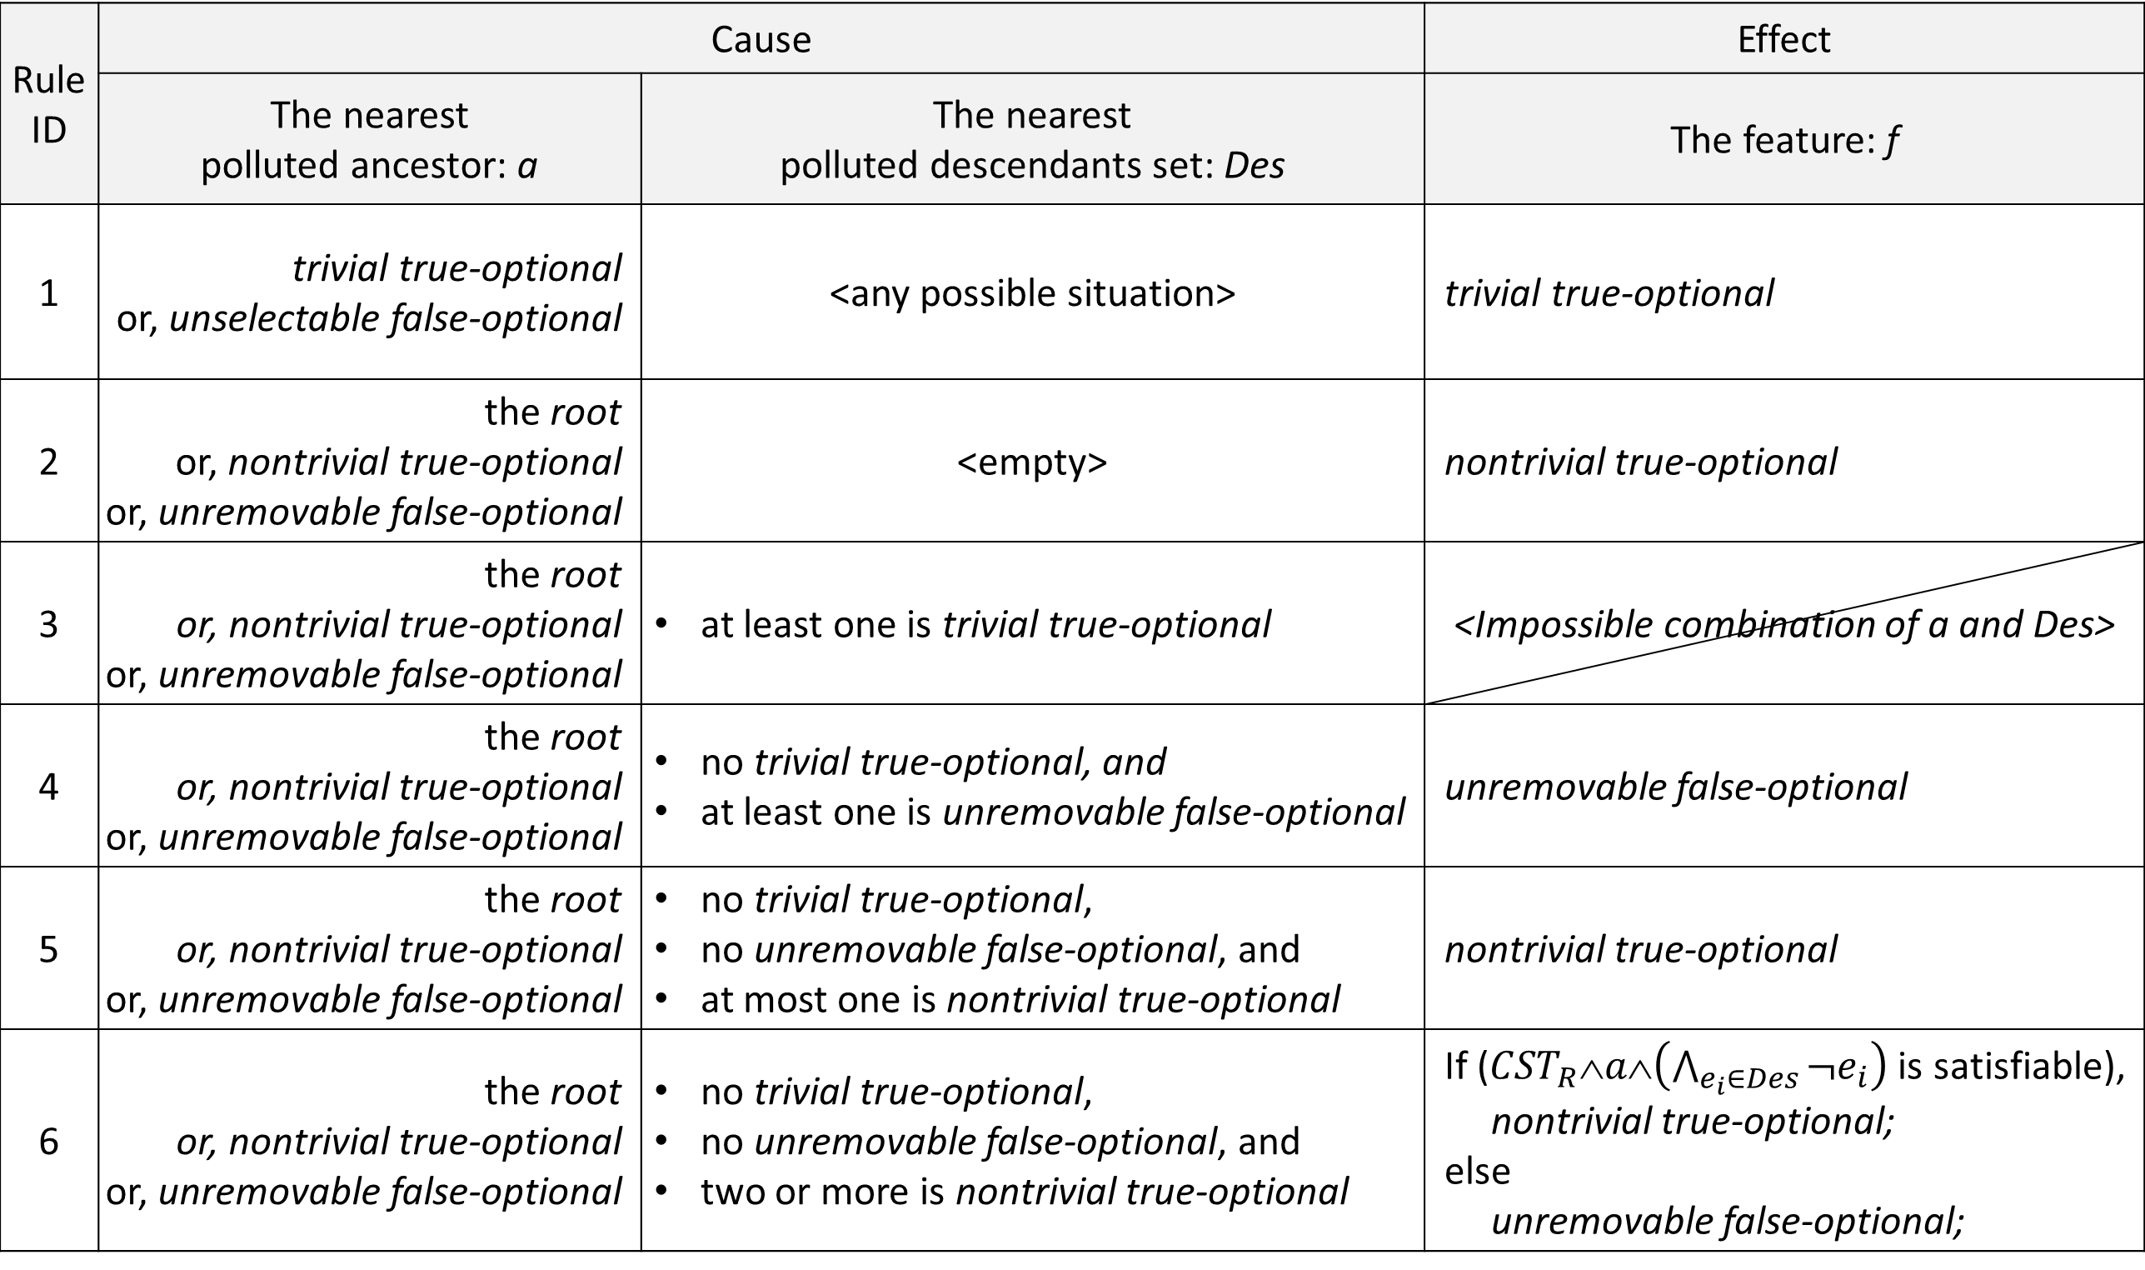
Rule ID | Cause |  | Effect
 | The nearest polluted ancestor: a | The nearest polluted descendants set: Des | The feature: f
1 | trivial true-optional or, unselectable false-optional | <any possible situation> | trivial true-optional
2 | the root or, nontrivial true-optional or, unremovable false-optional | <empty> | nontrivial true-optional
3 | the root or, nontrivial true-optional or, unremovable false-optional | at least one is trivial true-optional | <Impossible combination of a and Des>
4 | the root or, nontrivial true-optional or, unremovable false-optional | no trivial true-optional, and at least one is unremovable false-optional | unremovable false-optional
5 | the root or, nontrivial true-optional or, unremovable false-optional | no trivial true-optional, no unremovable false-optional, and at most one is nontrivial true-optional | nontrivial true-optional
6 | the root or, nontrivial true-optional or, unremovable false-optional | no trivial true-optional, no unremovable false-optional, and two or more is nontrivial true-optional | If (${CST}_{R}∧a∧\left(\bigwedge_{e_{i}∈Des}{¬e_{i}}\right)$ is satisfiable), nontrivial true-optional; else unremovable false-optional;

